Slide 1
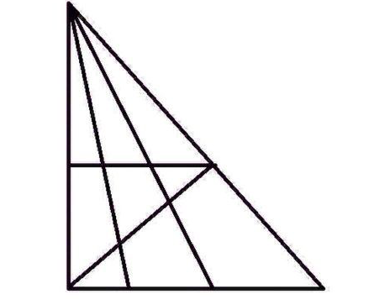
Brain Teaser: How many triangles can you find in the image below?
The answer: 24
https://www.youtube.com/watch?v=t9cxM_DQMXI

Slide 2
From last class:
What were the four tests that proved two triangles were congruent?

Slide 3
24
7
30
Date
Tests for Congruency
EQ – What are the test for congruency in triangles and how do they apply to quadrilaterals?
Side-Side-Side (SSS)
B
E
F
A
C
D
AB ≅ DE
BC ≅ EF
AC ≅ DF
ΔABC ≅ Δ DEF
Summary -

Slide 4
24
7
30
Date
Tests for Congruency
EQ – What are the test for congruency in triangles and how do they apply to quadrilaterals?
Side-Angle-Side (SAS)
B
E
F
A
C
D
AB ≅ DE
∠A ≅ ∠ D
AC ≅ DF
ΔABC ≅ Δ DEF
included
angle
Summary -

Slide 5
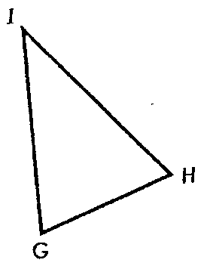

24
7
30
Date
Tests for Congruency
EQ – What are the test for congruency in triangles and how do they apply to quadrilaterals?
Included Angle
The angle between two sides
∠ G
∠ I
∠ H
Summary -

Slide 6
24
7
30
Date
Tests for Congruency
EQ – What are the test for congruency in triangles and how do they apply to quadrilaterals?
Name the included angle:
YE and ES
ES and YS
YS and YE
E
∠ E
∠ S
∠ Y
Y
S
Summary -

Slide 7

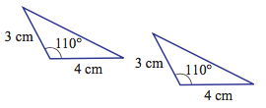
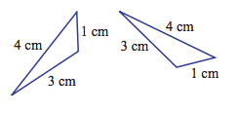

Label the congruency test you would use for each pair of triangles
1.
2.
3.
4.

Slide 8
24
7
30
Date
Tests for Congruency
EQ – What are the test for congruency in triangles and how do they apply to quadrilaterals?
B
E
F
Angle-Angle-Side (AAS, or ASA or SAA. Any order is accepted
A
C
D
∠A ≅ ∠ D
∠ B ≅ ∠ E
BC ≅ EF
ΔABC ≅ Δ DEF
Any equal, corresponding side
Summary -

Slide 9
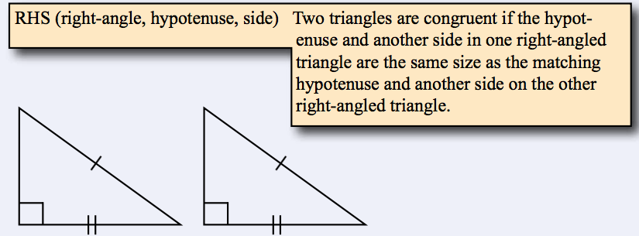
24
7
30
Date
Tests for Congruency
EQ – What are the test for congruency in triangles and how do they apply to quadrilaterals?
Summary -

Slide 10
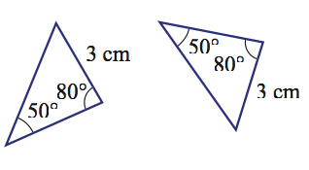
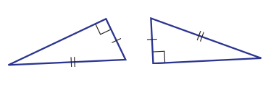
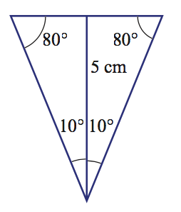
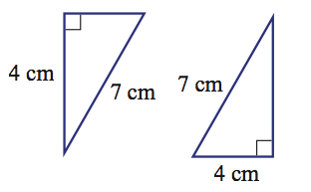
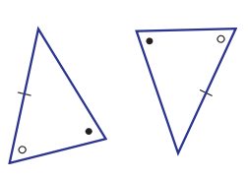
Label the congruency test you would use for each pair of triangles
1.
2.
5.
3.
4.

Slide 11
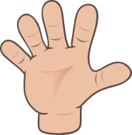
Do you understand? Fists of Five
Notes:
Check for Understanding

Slide 12
Warning: No SSA Test
There is no such thing as an SSA test!
B
E
F
A
C
D
NOT CONGRUENT

Slide 13
Warning: No AAA Test
There is no such thing as an AAA test!
B
E
A
C
F
D
NOT CONGRUENT

Slide 14
24
7
30
Date
Tests for Congruency
EQ – What are the test for congruency in triangles and how do they apply to quadrilaterals?
SSS correspondence
SAS correspondence
AAS correspondence
RHS correspondence
SSA correspondence
AAA correspondence
The Congruence Tests
Summary -

Slide 15
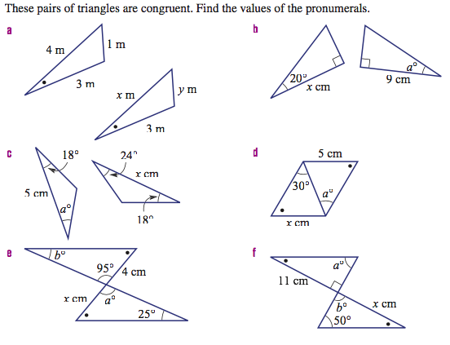

Slide 16
